Slide 1

Banking System Console Application
This C++ project showcases a comprehensive console-based banking application, encompassing features like account management, deposits, withdrawals, and balance inquiries.
Project Github Link

Slide 2

Key Features
1
Account Creation
Users can open new bank accounts with essential personal and financial details.
2
Balance Inquiry
Customers can easily check their account balances at any time.
3
Deposits & Withdrawals
The application handles both deposit and withdrawal transactions securely.
4
Account Closure
Users can close their accounts with a confirmation process.

Slide 3
Architectural Design
Object-Oriented Approach
Persistent Data Storage
Exception Handling
All account information is securely stored and retrieved using file handling techniques.
The application implements robust error management, such as preventing withdrawals beyond available balance.
The system is designed using C++ OOP principles, with modular classes for Account and Bank management.

Slide 4





Technical Highlights
C++
Leveraged the power of C++ for its object-oriented features and strong performance.
Encapsulation
Implemented data and method encapsulation within the Account and Bank classes.
Operator Overloading
Utilized operator overloading to simplify file I/O and account information display.
Data Structures
Leveraged the map data structure for efficient account storage and management.

Slide 5

Handling Challenges
Persistent Data
Ensured reliable data storage across sessions through file handling techniques.
Error Management
Implemented custom exceptions to handle over-withdrawals and other edge cases.
User Interface
Designed an intuitive CLI for user navigation and interaction.

Slide 6
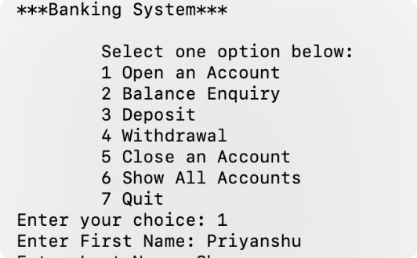
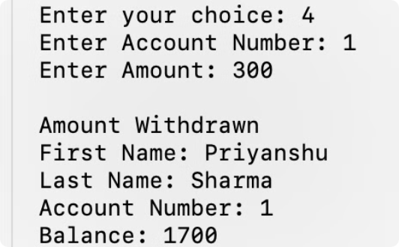
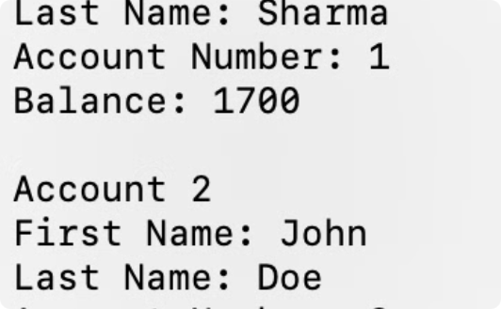
Demonstration & Code Snippets
Account Class
Bank Class
File I/O
Showcased key methods like Deposit(), Withdraw(), and file handling operators.
Demonstrated the implementation of account management and transaction handling.
Explained the process of saving and retrieving account data using file handling.

Slide 7

Future Enhancements
Additional Features
Graphical User Interface
Implement more advanced banking functionalities, such as loan management and interest calculations.
Develop a user-friendly GUI for a more intuitive banking experience.
1
2
3
Database Integration
Migrate to a database solution for improved scalability and data management.

Slide 8

Conclusion
This C++ project showcases a comprehensive understanding of object-oriented programming, file handling, and problem-solving skills. It serves as a strong foundation for developing real-world banking applications and demonstrates the ability to tackle complex software engineering challenges.

